Slide 1


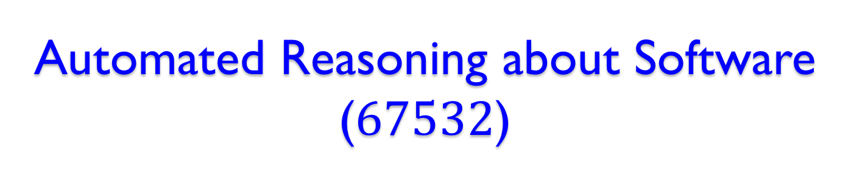
Automated Reasoning about Software ($67532$)
Guy Katz
Lecture $2$: SAT Solvers and DPLL November 4th, $2019$

Slide 2
Acknowledgements
Some of the material presented has been borrowed from slides by David Dill, Isil Dillig, Gera Weiss, Clark Barrett, Alex Aiken, Mooly Sagiv and Ofer Strichman

Slide 3
Definitions
Definition: A Boolean Satisfiability (SAT) solver is a program that automatically decides whether a propositional logic formula is satisfiable
UNSAT
Propositional Formula
SAT Solver
SAT + Assignment
רגע של עברית: לוגיקה פסוקית, ספיקות, השמה מספקת

Slide 4
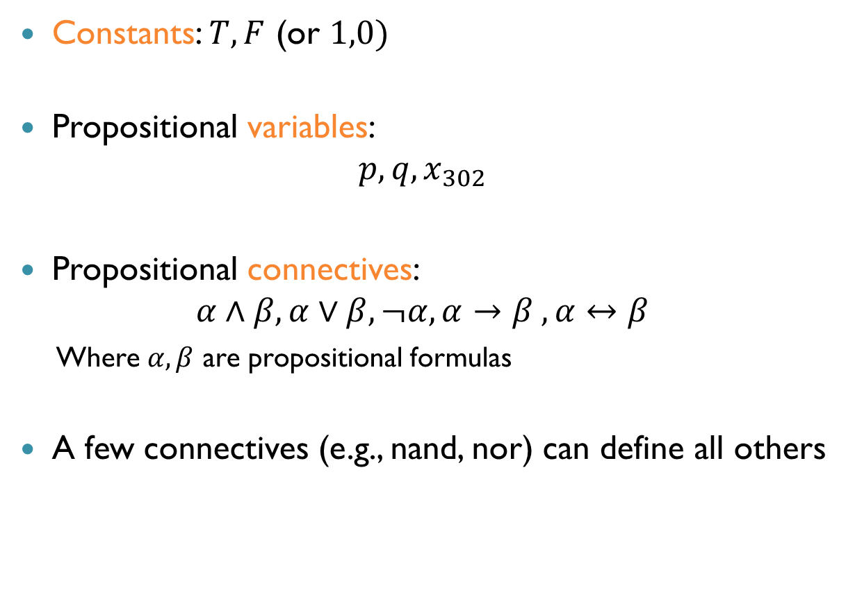
Propositional Logic
Constants: $T,F$ (or $1,0)$
Propositional variables:
$$p, q, x_{302}$$
Propositional connectives: $α∧β, α∨β,¬α, α→β , α↔β$
Where $α, β$ are propositional formulas
A few connectives (e.g., nand, nor) can define all others

Slide 5
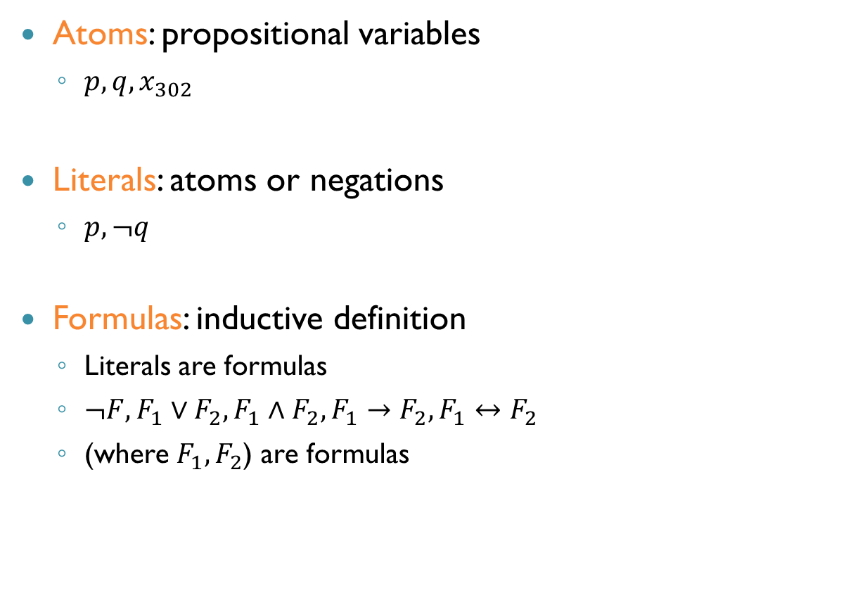
Propositional Logic (cnt’d)
Atoms: propositional variables
$p, q, x_{302}$
Literals: atoms or negations
$p, ¬q$
Formulas: inductive definition
Literals are formulas
$¬F, F_{1}∨F_{2},F_{1}∧F_{2},F_{1}→F_{2},F_{1}↔F_{2}$
(where $F_{1},F_{2}$) are formulas
רגע של עברית: אטום, ליטרל, נוסחה

Slide 6
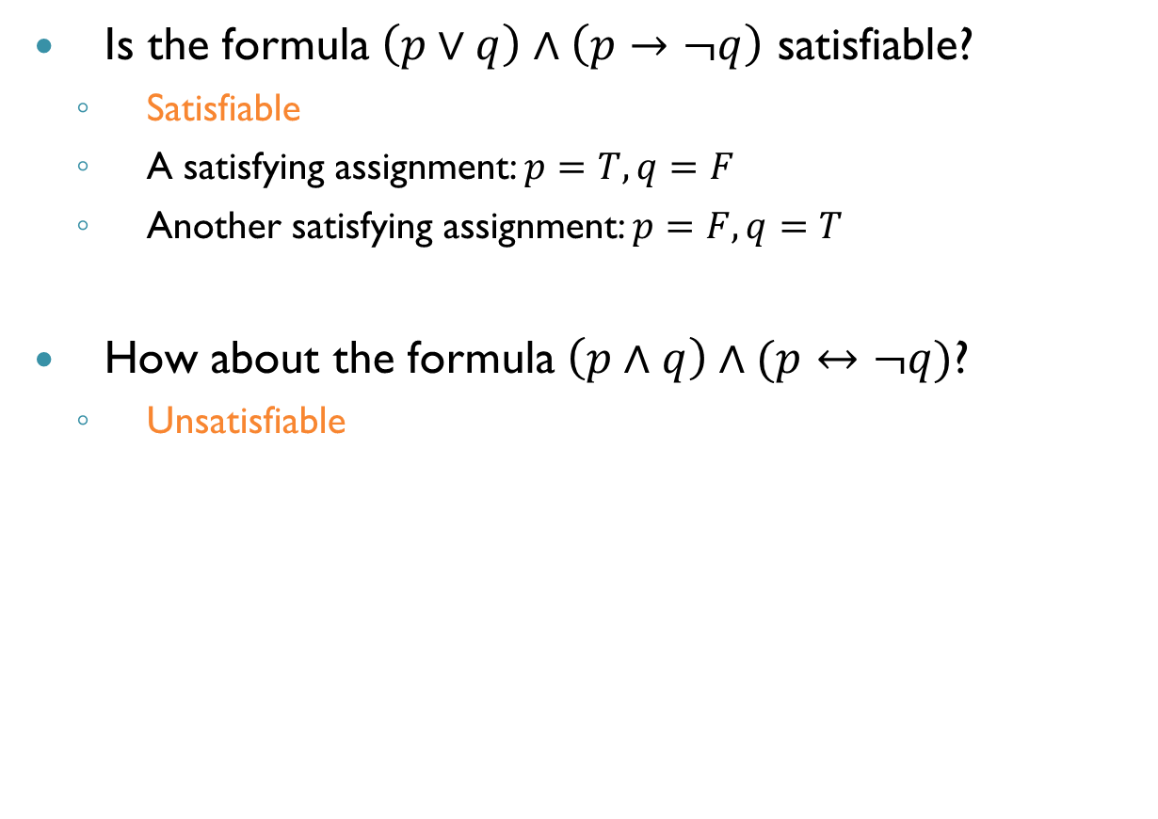
Examples
Is the formula $\left(p∨q\right)∧\left(p→¬q\right)$ satisfiable?
Satisfiable
A satisfying assignment: $p=T,q=F$
Another satisfying assignment: $p=F,q=T$
How about the formula $\left(p∧q\right)∧(p↔¬q)$?
Unsatisfiable

Slide 7
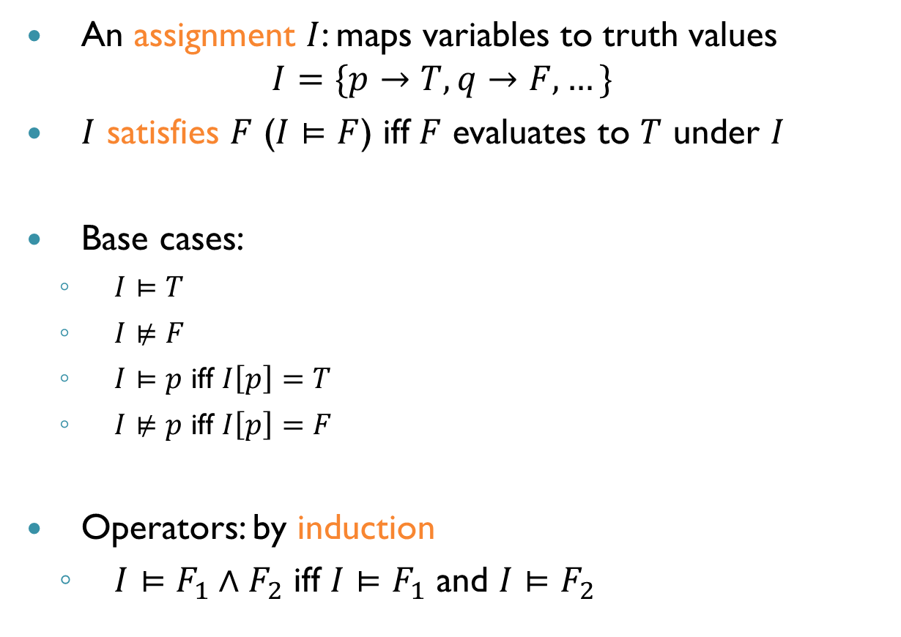
Assignments
An assignment $I$: maps variables to truth values $I=\{p→T, q→F,…\}$
$I$ satisfies $F$ ($I⊨F$) iff $F$ evaluates to $T$ under $I$
Base cases:
$I⊨T$
$I⊭F$
$I⊨p$ iff $I\left[p\right]=T$
$I⊭p$ iff $I\left[p\right]=F$
Operators: by induction
$I⊨F_{1}∧F_{2}$ iff $I⊨F_{1}$ and $I⊨F_{2}$

Slide 8
Motivation
The SAT problem is the NP-complete problem
All NP-complete problems mutually reducible
So, just need to solve one problem really well
Both algorithms and engineering
This has worked fairly well in verification

Slide 9
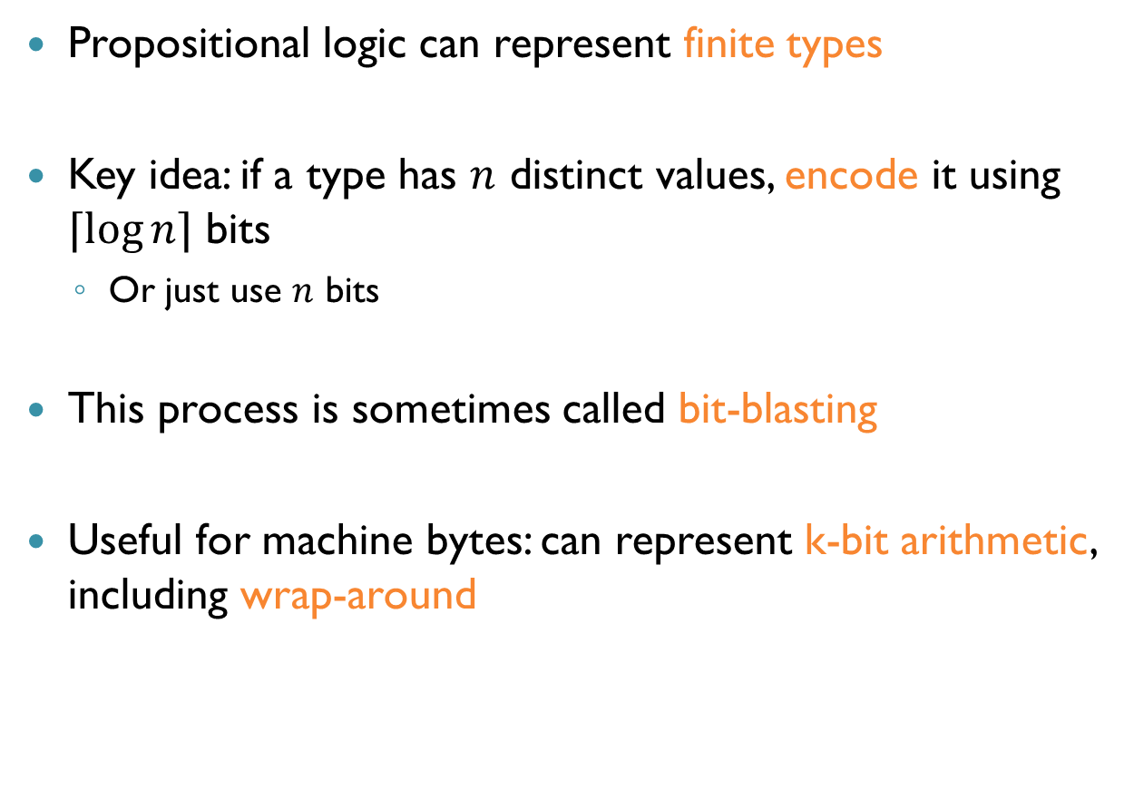
Expressiveness
Propositional logic can represent finite types
Key idea: if a type has $n$ distinct values, encode it using $⌈\log{n}⌉$ bits
Or just use $n$ bits
This process is sometimes called bit-blasting
Useful for machine bytes: can represent k-bit arithmetic, including wrap-around

Slide 10
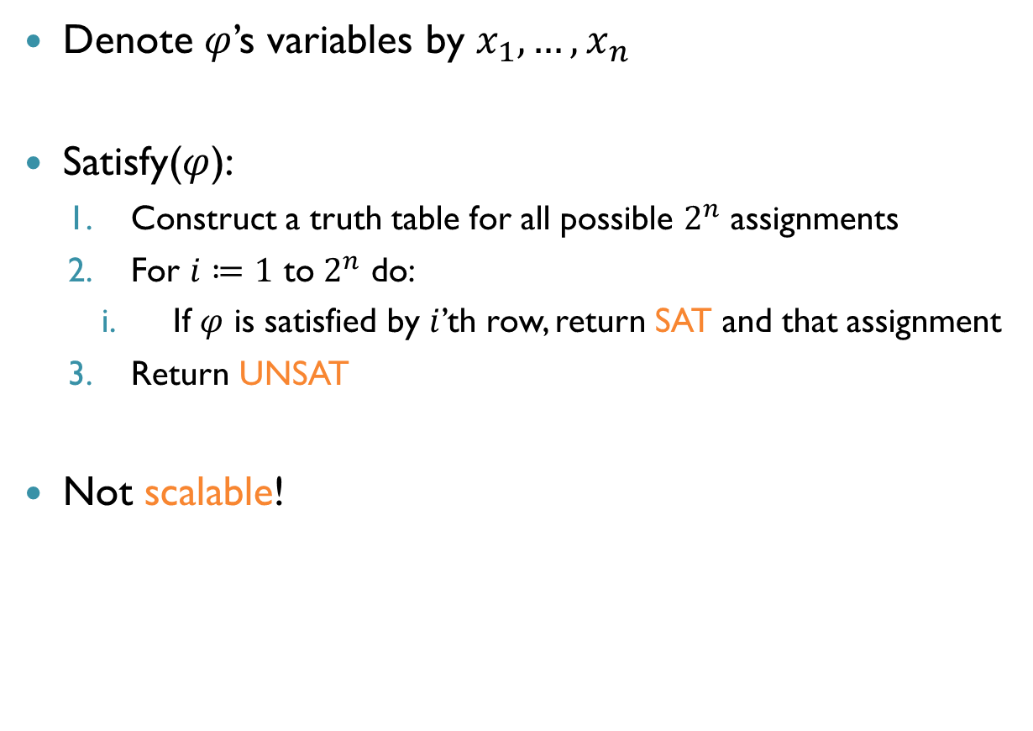
Naïve Algorithm
Denote $φ$’s variables by $x_{1},…, x_{n}$
Satisfy($φ$):
Construct a truth table for all possible $2^{n}$ assignments
For $i≔1$ to $2^{n}$ do:
If $φ$ is satisfied by $i$’th row, return SAT and that assignment
Return UNSAT
Not scalable!

Slide 11
Modern SAT Solver Architecture
UNSAT
Propositional Formula
SAT Solver
SAT + Assignment
SAT Solver
Search
Preprocess Formula
Deduction

Slide 12
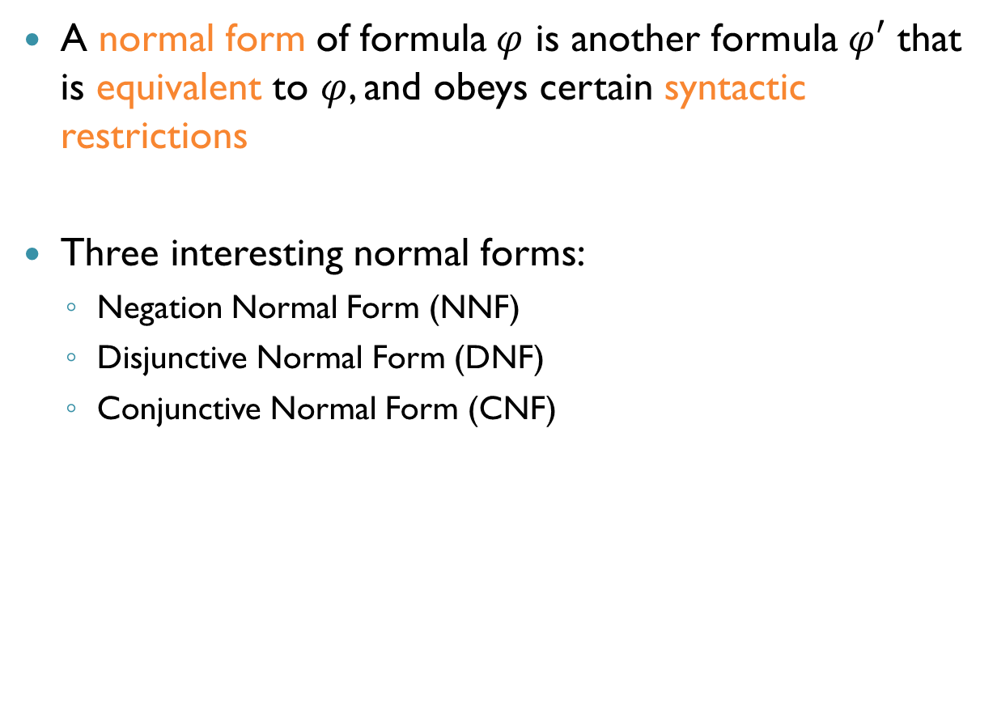
Normal Forms
A normal form of formula $φ$ is another formula $φ′$ that is equivalent to $φ$, and obeys certain syntactic restrictions
Three interesting normal forms:
Negation Normal Form (NNF)
Disjunctive Normal Form (DNF)
Conjunctive Normal Form (CNF)

Slide 13


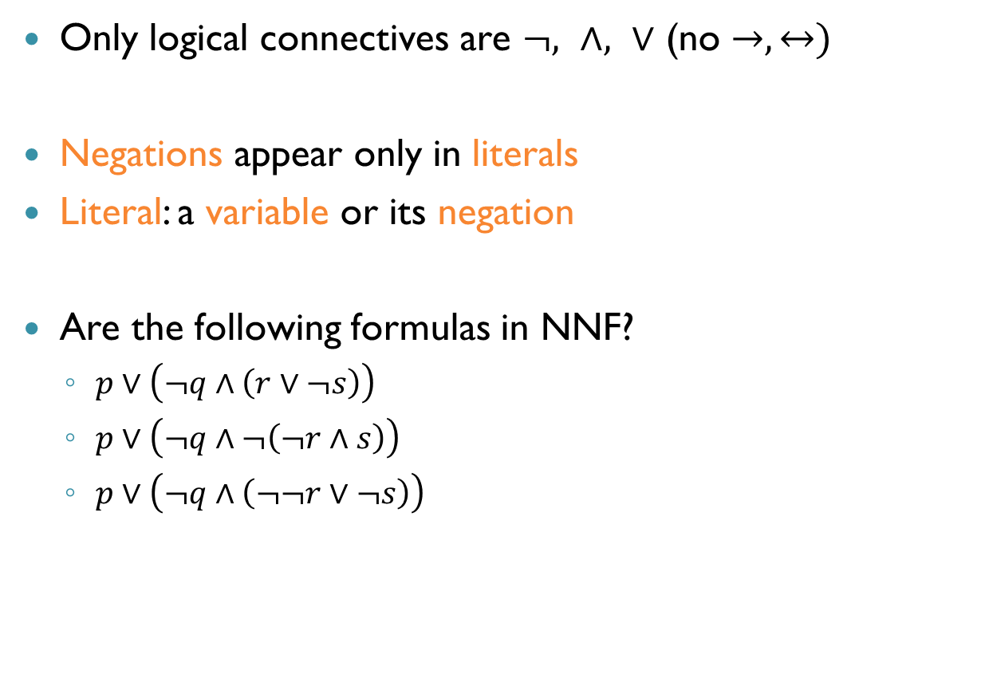
Negation Normal Form (NNF)
Only logical connectives are $¬, ∧, ∨$ (no $→, ↔)$
Negations appear only in literals
Literal: a variable or its negation
Are the following formulas in NNF?
$p∨\left(¬q∧\left(r∨¬s\right)\right)$
$p∨\left(¬q∧¬\left(¬r∧s\right)\right)$
$p∨\left(¬q∧\left(¬¬r∨¬s\right)\right)$
רגע של עברית: נוסחה בצורת שלילה נורמלית

Slide 14
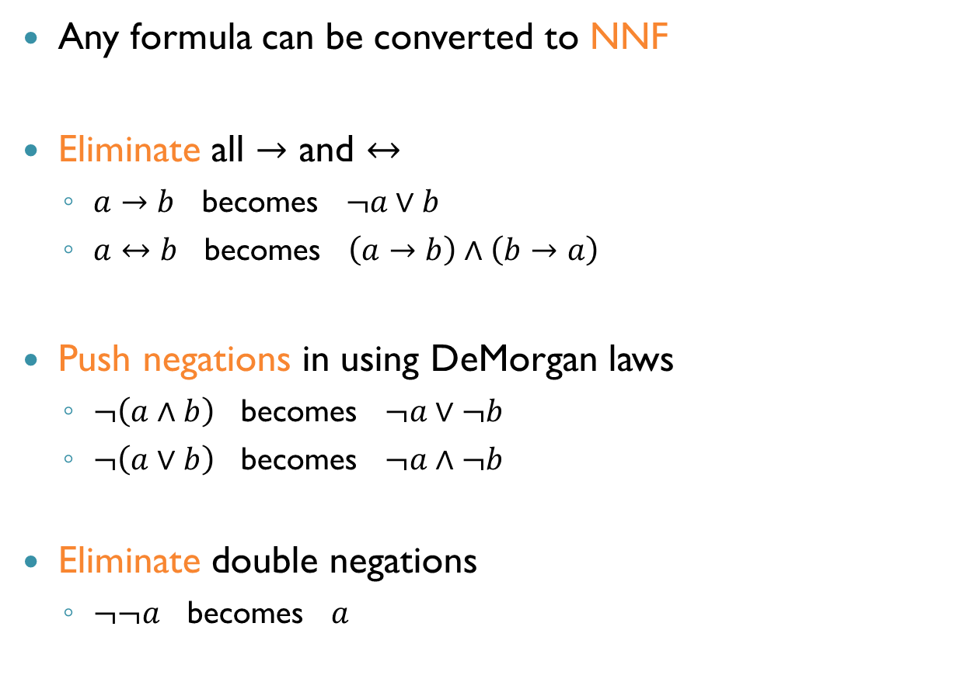
Conversion to NNF
Any formula can be converted to NNF
Eliminate all $→$ and $↔$
$a→b$ becomes $¬a∨b$
$a↔b$ becomes $\left(a→b\right)∧\left(b→a\right)$
Push negations in using DeMorgan laws
$¬\left(a∧b\right)$ becomes $¬a∨¬b$
$¬\left(a∨b\right)$ becomes $¬a∧¬b$
Eliminate double negations
$¬¬a$ becomes $a$

Slide 15

Conversion to NNF (cnt’d)
Example: convert the following formula to NNF $¬\left(p→\left(p∧q\right)\right)$
$¬\left(¬p∨\left(p∧q\right)\right)$
$¬¬p∧¬\left(p∧q\right)$
$p∧(¬p∨¬q)$

Slide 16
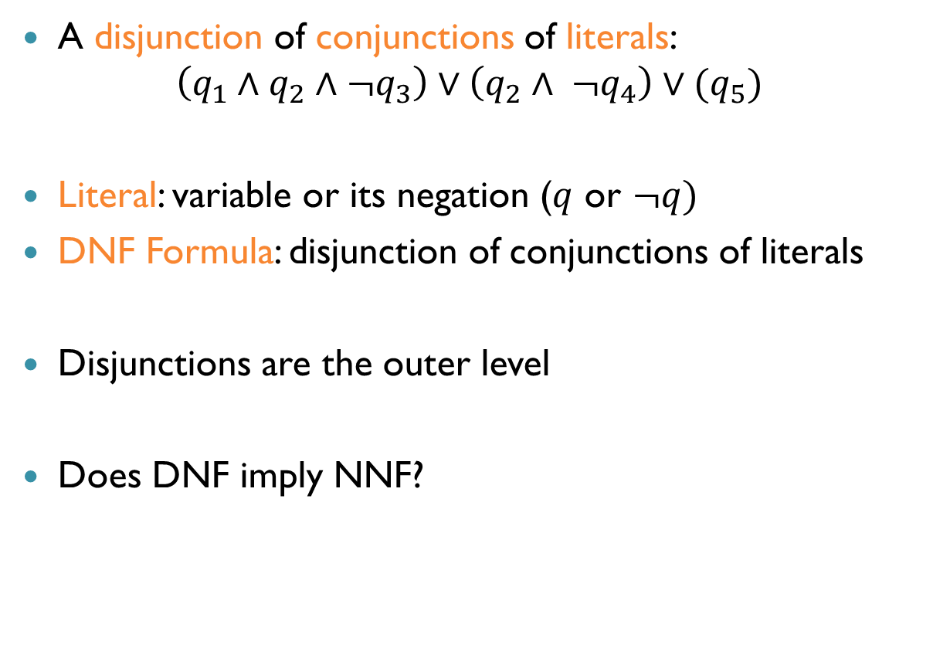
Disjunctive Normal Form (DNF)
A disjunction of conjunctions of literals:
$$\left(q_{1}∧q_{2}∧¬q_{3}\right)∨\left(q_{2}∧ ¬q_{4}\right)∨(q_{5})$$
Literal: variable or its negation ($q$ or $¬q)$
DNF Formula: disjunction of conjunctions of literals
Disjunctions are the outer level
Does DNF imply NNF?
רגע של עברית: גימום (קוניונקציה), איווי (דיסיונקציה), ליטרל,
נוסחה בצורת דיסיונקציה נורמלית

Slide 17

Conversion to DNF
Any formula can be converted to DNF
Convert to NNF
Then distribute over $∧$ and $∨$
$\left(a∨b\right)∧c$ becomes $\left(a∧c\right)∨(b∧c)$
$a∧(b∨c)$ becomes $\left(a∧b\right)∨(a∧c)$

Slide 18
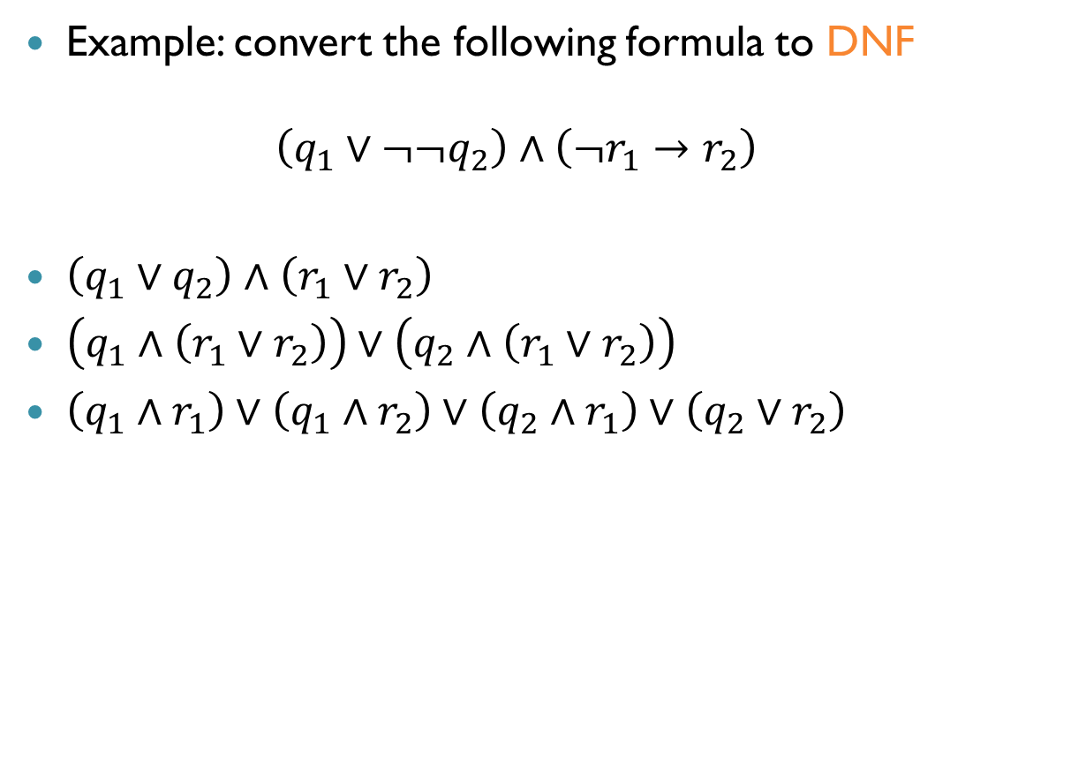
Conversion to DNF (cnt’d)
Example: convert the following formula to DNF $\left(q_{1}∨¬¬q_{2}\right)∧\left(¬r_{1}→r_{2}\right)$
$\left(q_{1}∨q_{2}\right)∧\left(r_{1}∨r_{2}\right)$
$\left(q_{1}∧\left(r_{1}∨r_{2}\right)\right)∨\left(q_{2}∧\left(r_{1}∨r_{2}\right)\right)$
$\left(q_{1}∧r_{1}\right)∨\left(q_{1}∧r_{2}\right)∨\left(q_{2}∧r_{1}\right)∨\left(q_{2}∨r_{2}\right)$

Slide 19
Satisfiability of DNF Formulas
Checking the satisfiability of DNF formula is trivial
Complexity: linear in size of formula
Idea: check satisfiability by converting to DNF

Slide 20
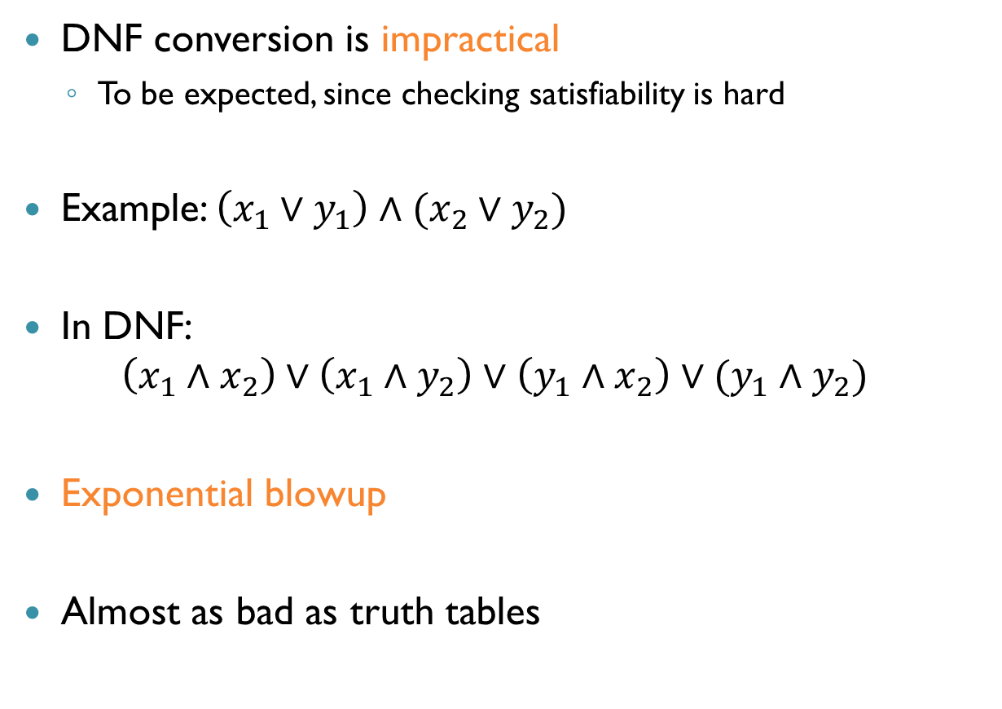
Formula Size Blow-up
DNF conversion is impractical
To be expected, since checking satisfiability is hard
Example: $\left(x_{1}∨y_{1}\right)∧(x_{2}∨y_{2})$
In DNF: $\left(x_{1}∧x_{2}\right)∨\left(x_{1}∧y_{2}\right)∨\left(y_{1}∧x_{2}\right)∨(y_{1}∧y_{2})$
Exponential blowup
Almost as bad as truth tables

Slide 21
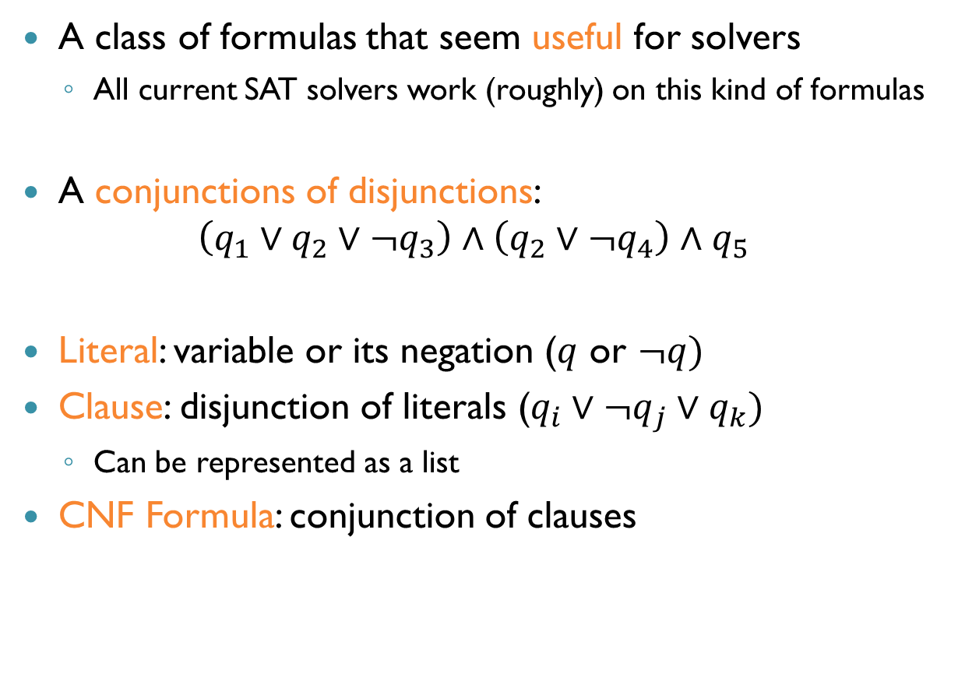
Conjunctive Normal Form (CNF)
A class of formulas that seem useful for solvers
All current SAT solvers work (roughly) on this kind of formulas
A conjunctions of disjunctions: $\left(q_{1}∨q_{2}∨¬q_{3}\right)∧\left(q_{2}∨¬q_{4}\right)∧q_{5}$
Literal: variable or its negation ($q$ or $¬q)$
Clause: disjunction of literals ($q_{i}∨¬q_{j}∨q_{k})$
Can be represented as a list
CNF Formula: conjunction of clauses
רגע של עברית: גימום (קוניונקציה), איווי (דיסיונקציה), ליטרל, פסוקית,
נוסחה בצורת קוניונקציה נורמלית

Slide 22

Conversion to CNF
Convert to NNF
Then distribute over $∧$ and $∨$
$\left(a∧b\right)∨c$ becomes $\left(a∨c\right)∧(b∨c)$
$a∨(b∧c)$ becomes $\left(a∨b\right)∧(a∨c)$

Slide 23
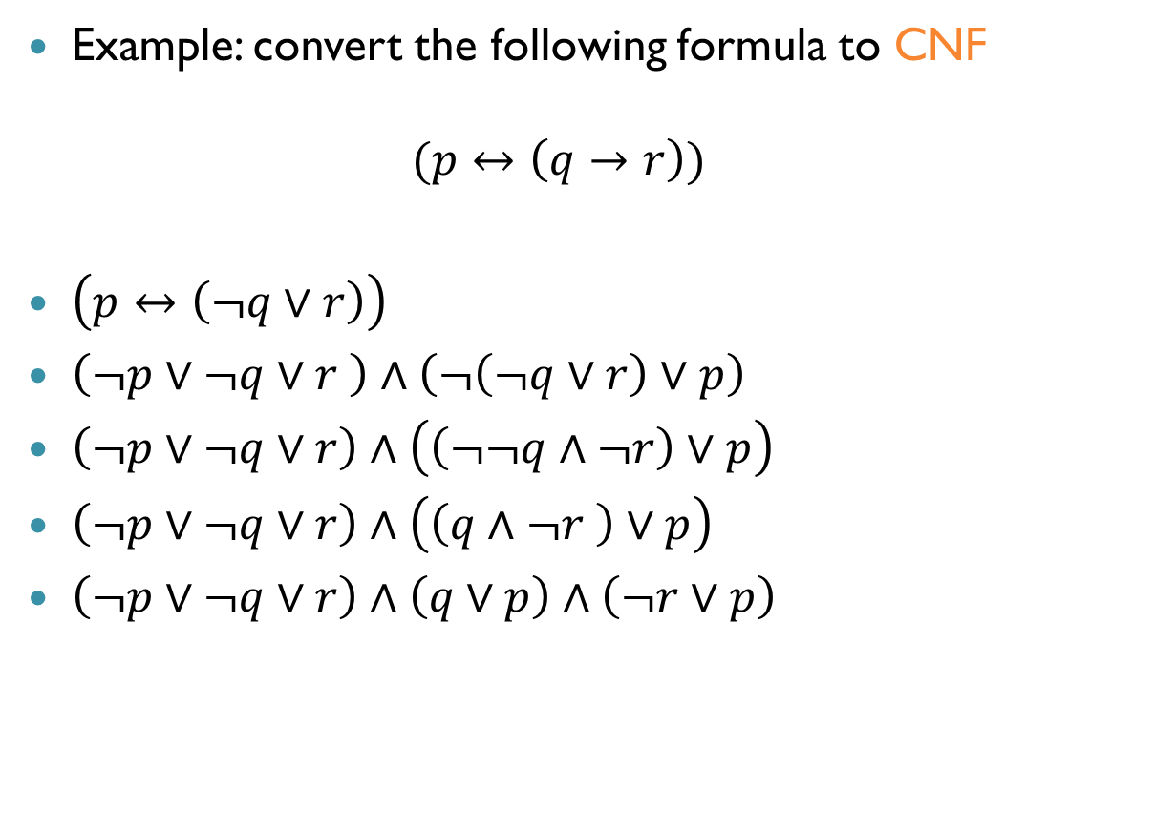
Conversion to CNF (cnt’d)
Example: convert the following formula to CNF $(p↔\left(q→r\right))$
$\left(p↔\left(¬q∨r\right)\right)$
$\left(¬p∨¬q∨r \right)∧\left(¬\left(¬q∨r\right)∨p\right)$
$\left(¬p∨¬q∨r\right)∧\left(\left(¬¬q∧¬r\right)∨p\right)$
$\left(¬p∨¬q∨r\right)∧\left(\left(q∧¬r \right)∨p\right)$
$\left(¬p∨¬q∨r\right)∧\left(q∨p\right)∧\left(¬r∨p\right)$

Slide 24
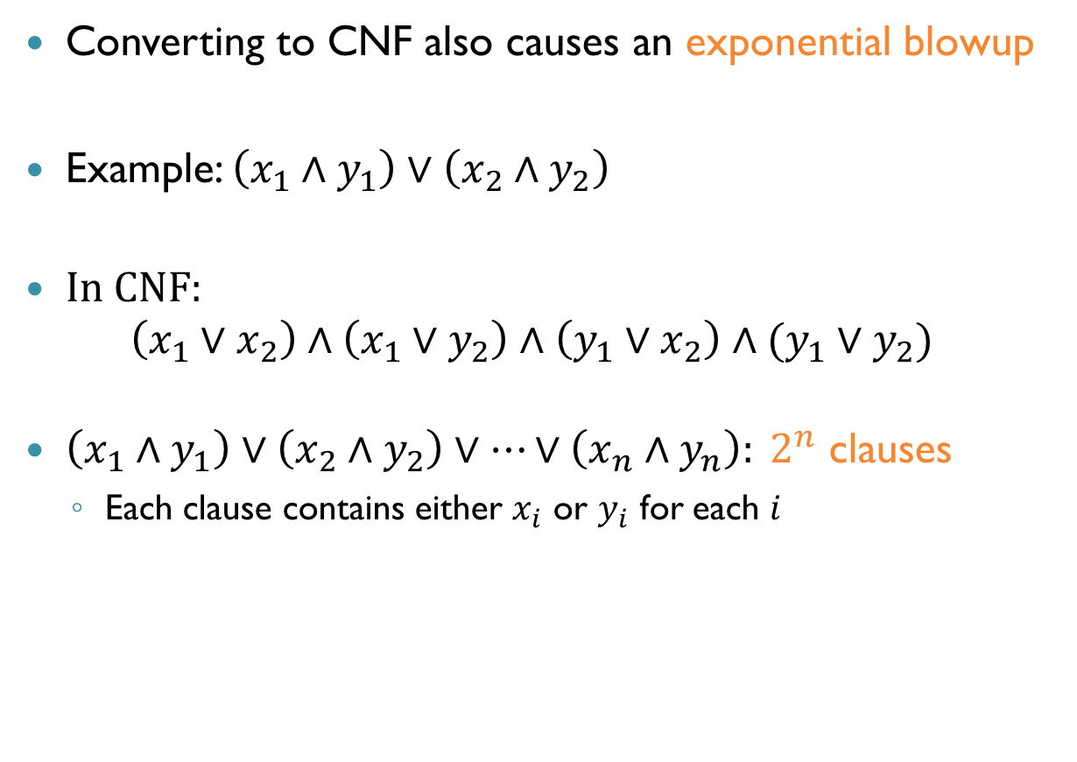
Converting to CNF (cnt’d)
Converting to CNF also causes an exponential blowup
Example: $\left(x_{1}∧y_{1}\right)∨\left(x_{2}∧y_{2}\right)$
In CNF: $\left(x_{1}∨x_{2}\right)∧\left(x_{1}∨y_{2}\right)∧\left(y_{1}∨x_{2}\right)∧(y_{1}∨y_{2})$
$\left(x_{1}∧y_{1}\right)∨\left(x_{2}∧y_{2}\right)∨…∨\left(x_{n}∧y_{n}\right): 2^{n}$ clauses
Each clause contains either $x_{i}$ or $y_{i}$ for each $i$

Slide 25
CNF Vs. DNF
Both conversion may cause an exponential blowup
And it is much easier to solve in DNF
And yet, almost all solvers convert to CNF!
The trick: Equisatisfiability

Slide 26
Tseitin’s Transformation
Key idea: add new variables so formula remains small
New variables act as names for subformulas
New formula is equisatisfiable to the original
Original is satisfiable if and only if new formula is satisfiable
Weaker notion than equivalence
If SAT assignment discovered, delete new variables to obtain SAT assignment for original formula
Blowup only linear, quite fast in practice

Slide 27

Tseitin’s Transformation (cnt’d)
Step $1$: For every subformula $G$ introduce variable $p_{G}$
Unless $G$ already a literal
Example: $φ=\left(p∧q\right)∨\left(t∧s\right)$
$p_{G_{1}}:φ$
$p_{G_{2}}:p∧q$
$p_{G_{3}}:t∧s$

Slide 28
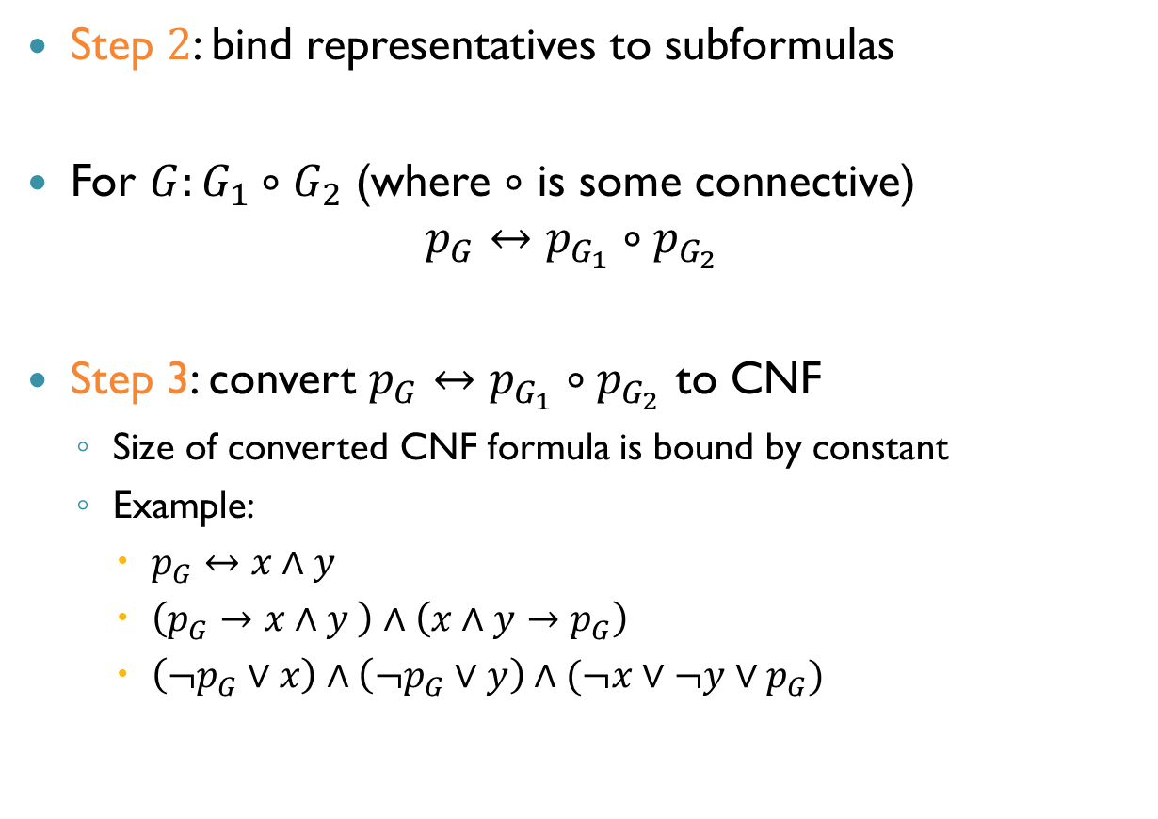
Tseitin’s Transformation (cnt’d)
Step $2$: bind representatives to subformulas
For $G:G_{1}∘G_{2}$ (where $∘$ is some connective) $p_{G}↔p_{G_{1}}∘p_{G_{2}}$
Step 3: convert $p_{G}↔p_{G_{1}}∘p_{G_{2}}$ to CNF
Size of converted CNF formula is bound by constant
Example:
$p_{G}↔x∧y$
$\left(p_{G}→x∧y \right)∧\left(x∧y→p_{G}\right)$
$\left(¬p_{G}∨x\right)∧\left(¬p_{G}∨y\right)∧(¬x∨¬y∨p_{G})$

Slide 29

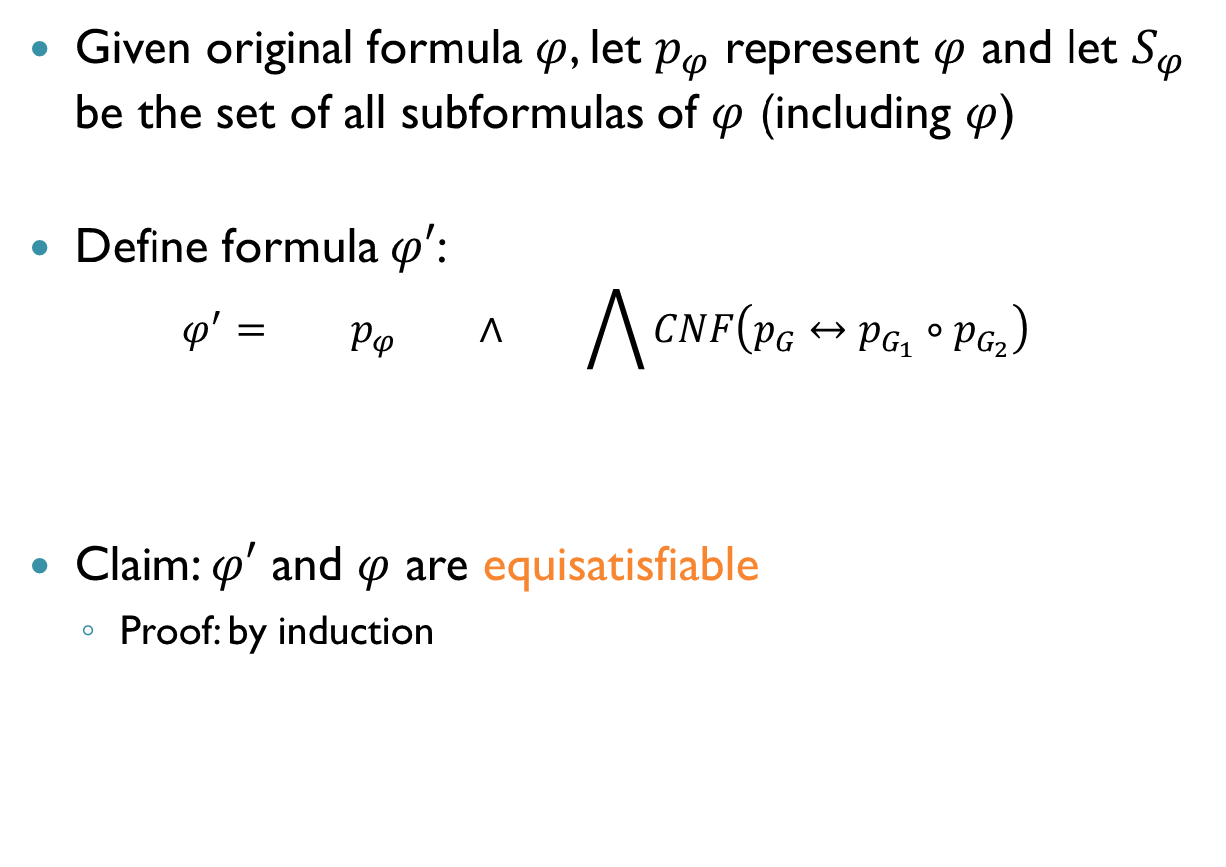
Tseitin’s Transformation (cnt’d)
Given original formula $φ$, let $p_{φ}$ represent $φ$ and let $S_{φ}$ be the set of all subformulas of $φ$ (including $φ$)
Define formula $φ′$: $φ^{′}= p_{φ} ∧ \bigwedge{CNF\left(p_{G}↔p_{G_{1}}∘p_{G_{2}}\right)}$
Claim: $φ′$ and $φ$ are equisatisfiable
Proof: by induction
$$G=\left(G_{1}∘G_{2}\right)∈S_{φ}$$

Slide 30
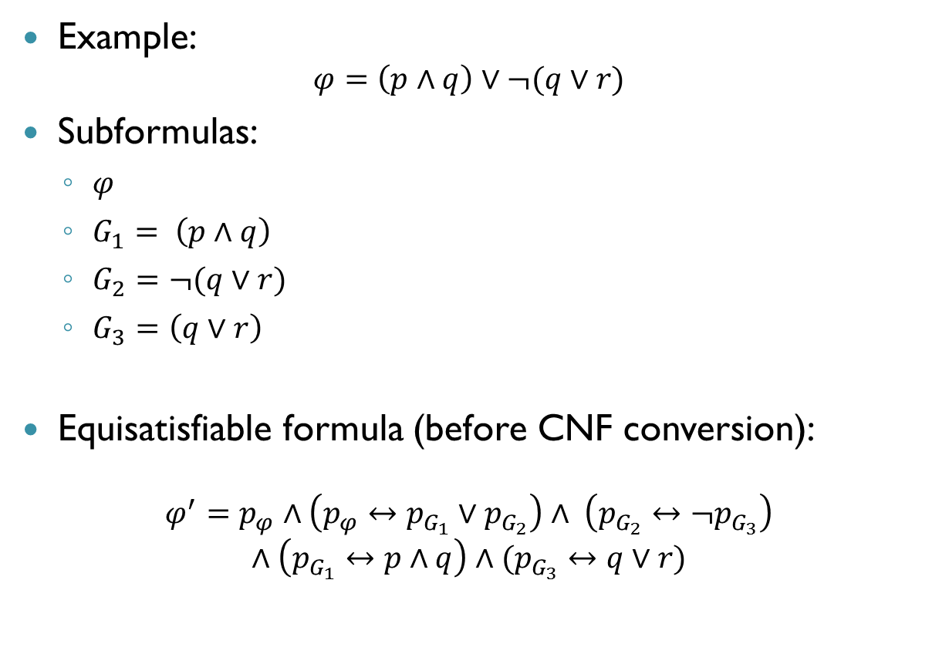
Tseitin’s Transformation (cnt’d)
Example: $φ=\left(p∧q\right)∨¬(q∨r)$
Subformulas:
$φ$
$G_{1}= \left(p∧q\right)$
$G_{2}=¬(q∨r)$
$G_{3}=\left(q∨r\right)$
Equisatisfiable formula (before CNF conversion):
$$φ^{′}=p_{φ}∧\left(p_{φ}↔p_{G_{1}}∨p_{G_{2}}\right)∧ \left(p_{G_{2}}↔¬p_{G_{3}}\right)$$
$$∧\left(p_{G_{1}}↔p∧q\right)∧(p_{G_{3}}↔q∨r)$$

Slide 31
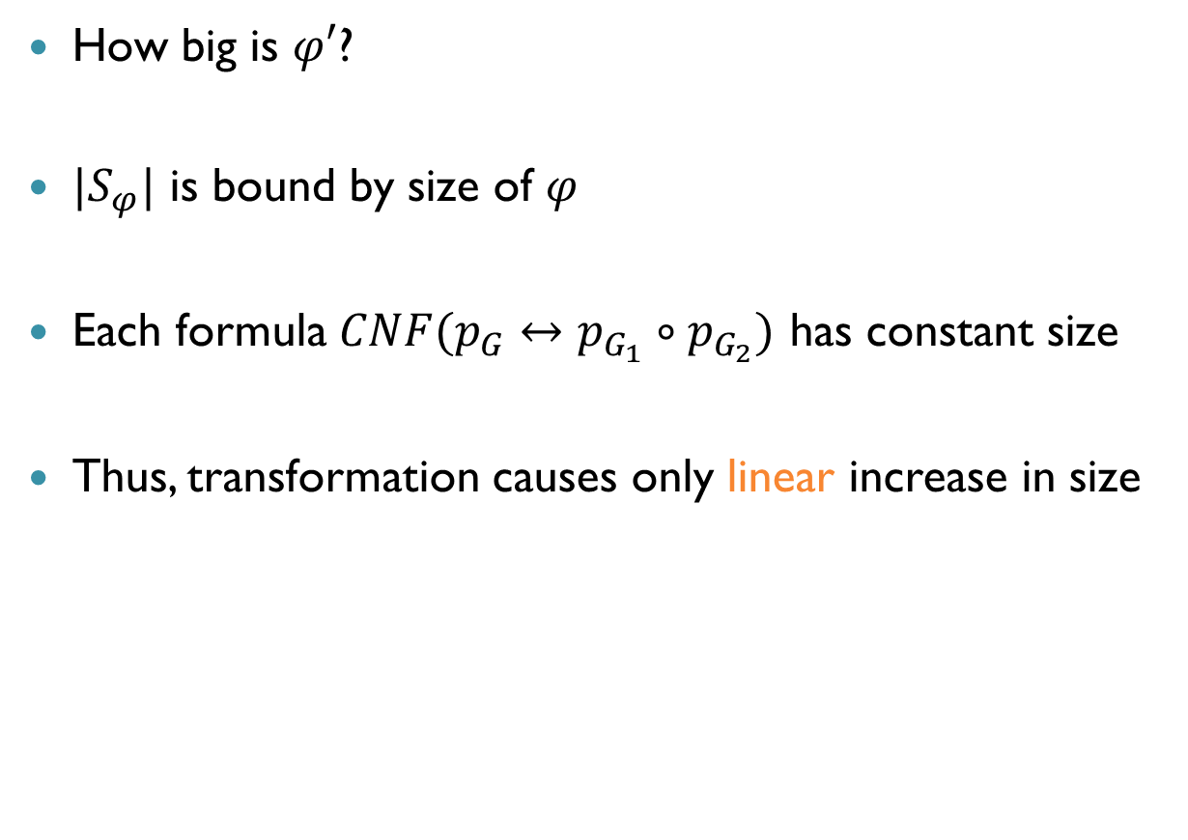
Tseitin’s Transformation (cnt’d)
How big is $φ′$?
$|S_{φ}|$ is bound by size of $φ$
Each formula $CNF(p_{G}↔p_{G_{1}}∘p_{G_{2}})$ has constant size
Thus, transformation causes only linear increase in size

Slide 32
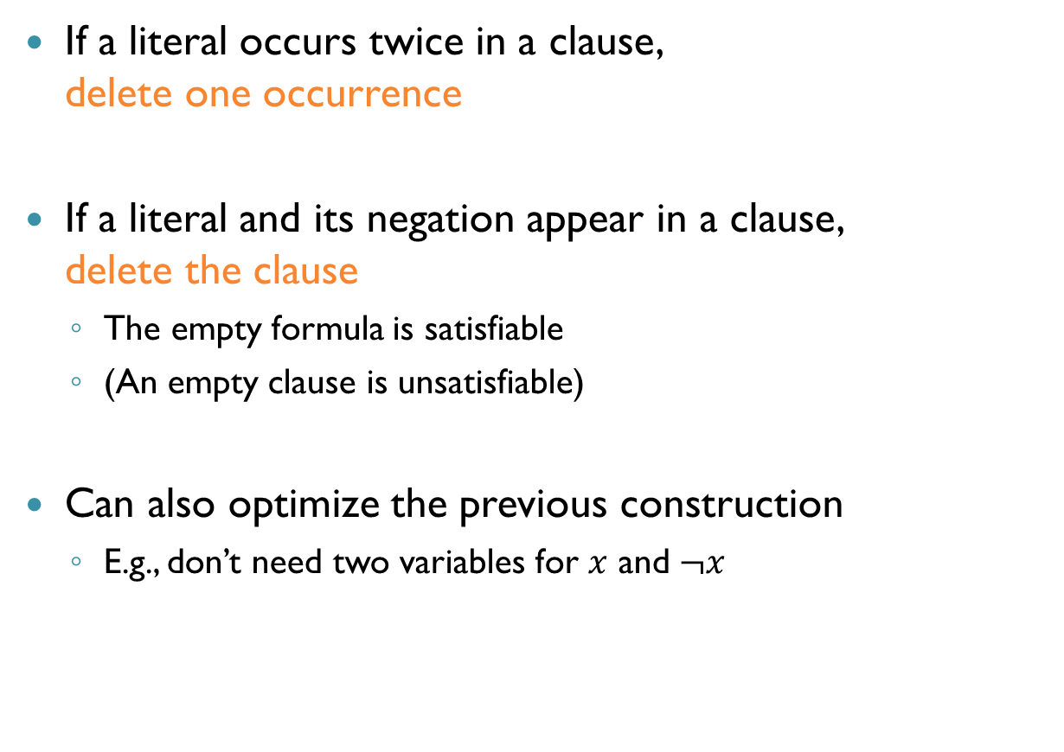
Other Preprocessing
If a literal occurs twice in a clause, delete one occurrence
If a literal and its negation appear in a clause, delete the clause
The empty formula is satisfiable
(An empty clause is unsatisfiable)
Can also optimize the previous construction
E.g., don’t need two variables for $x$ and $¬x$

Slide 33
Modern SAT Solver Architecture
UNSAT
Propositional Formula
SAT Solver
SAT + Assignment
SAT Solver
Search
Preprocess Formula
Deduction

Slide 34
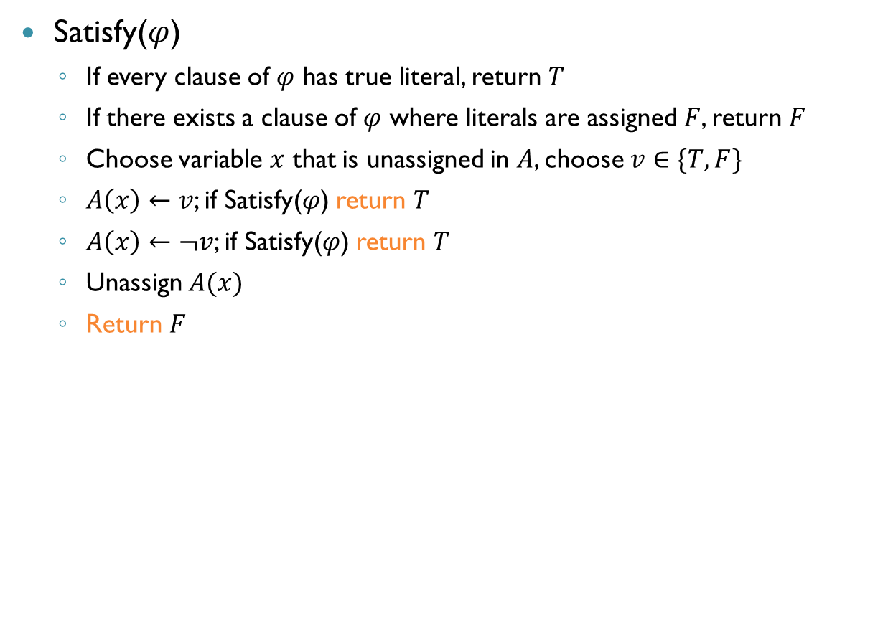
Basic Search Algorithm
Satisfy($φ$)
If every clause of $φ$ has true literal, return $T$
If there exists a clause of $φ$ where literals are assigned $F$, return $F$
Choose variable $x$ that is unassigned in $A$, choose $v∈\{T,F\}$
$A\left(x\right)←v$; if Satisfy($φ$) return $T$
$A\left(x\right)←¬v$; if Satisfy($φ$) return $T$
Unassign $A(x)$
Return $F$

Slide 35
























The Underlying Search Tree
Variables: $x_{1},x_{2},x_{3}$
$$x_{1}$$
$$F$$
$$T$$
$$x_{2}$$
$$x_{2}$$
$$F$$
$$T$$
$$F$$
$$T$$
$$x_{3}$$
$$x_{3}$$
$$x_{3}$$
$$x_{3}$$
$$F$$
$$T$$
$$F$$
$$T$$
$$F$$
$$T$$
$$F$$
$$T$$

Slide 36
Deduction
Searching through all possible assignments is inefficient
Key idea: deduce facts that prune the search space
Rule out assignments that we don’t need to check
This complements (doesn’t replace) the search
We will see some of the rules that modern solvers use

Slide 37
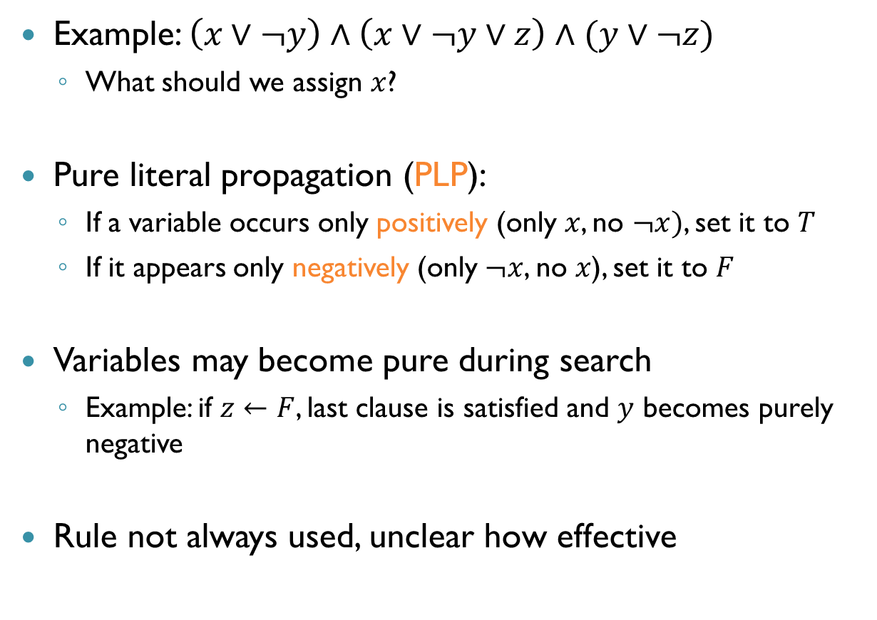
Deduction: Pure Literals
Example: $\left(x∨¬y\right)∧\left(x∨¬y∨z\right)∧(y∨¬z)$
What should we assign $x$?
Pure literal propagation (PLP):
If a variable occurs only positively (only $x$, no $¬x)$, set it to $T$
If it appears only negatively (only $¬x$, no $x$), set it to $F$
Variables may become pure during search
Example: if $z←F$, last clause is satisfied and $y$ becomes purely negative
Rule not always used, unclear how effective

Slide 38
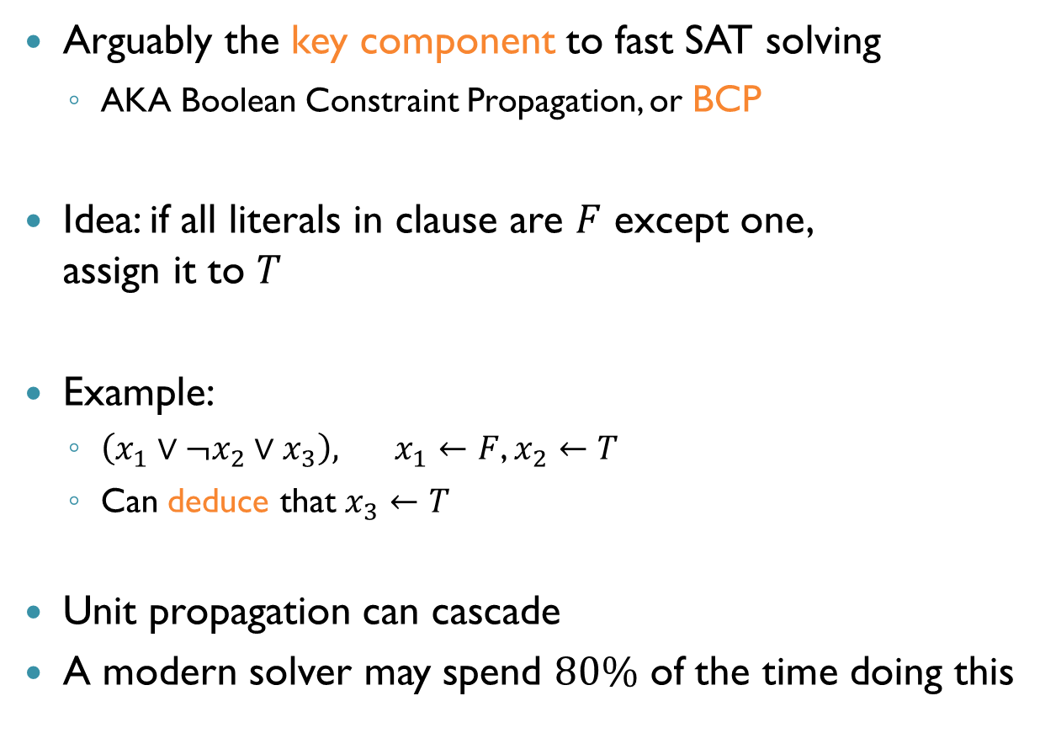
Deduction: Unit Propagation
Arguably the key component to fast SAT solving
AKA Boolean Constraint Propagation, or BCP
Idea: if all literals in clause are $F$ except one, assign it to $T$
Example:
$\left(x_{1}∨¬x_{2}∨x_{3}\right), x_{1}←F$, $x_{2}←T$
Can deduce that $x_{3}←T$
Unit propagation can cascade
A modern solver may spend $80\%$ of the time doing this

Slide 39
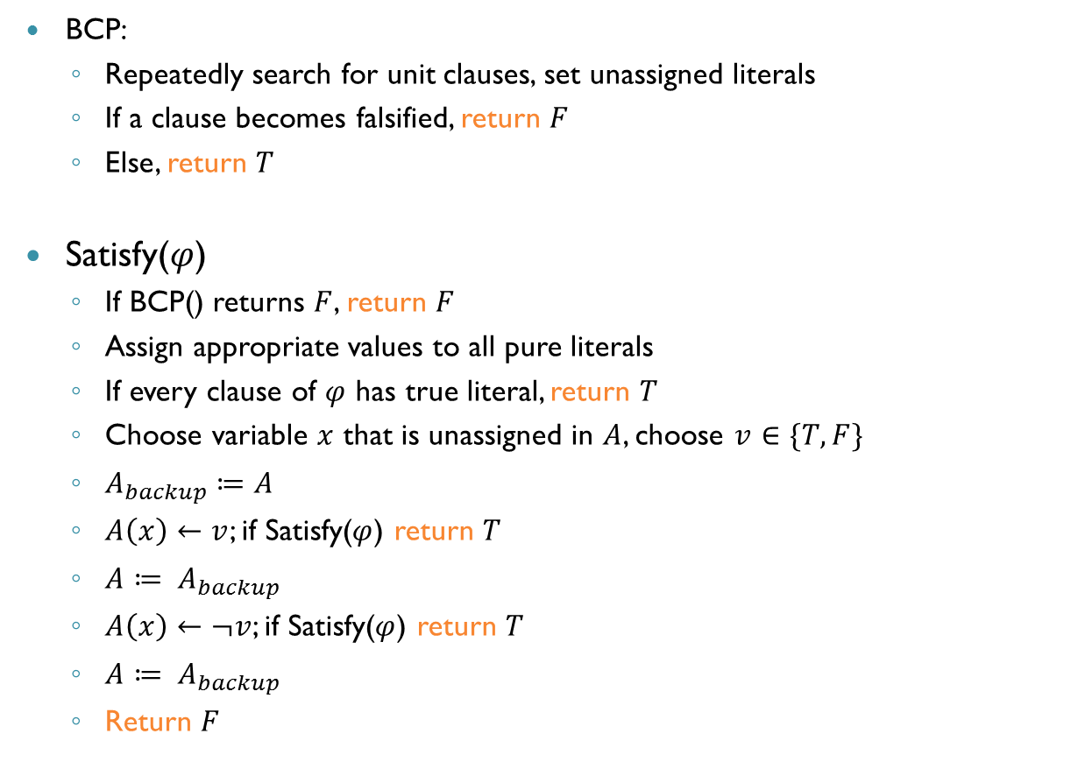
Algorithm So Far
BCP:
Repeatedly search for unit clauses, set unassigned literals
If a clause becomes falsified, return $F$
Else, return $T$
Satisfy($φ$)
If BCP() returns $F$, return $F$
Assign appropriate values to all pure literals
If every clause of $φ$ has true literal, return $T$
Choose variable $x$ that is unassigned in $A$, choose $v∈\{T,F\}$
$A_{backup}≔A$
$A\left(x\right)←v$; if Satisfy($φ$) return $T$
$A≔ A_{backup}$
$A\left(x\right)←¬v$; if Satisfy($φ$) return $T$
$A≔ A_{backup}$
Return $F$

Slide 40
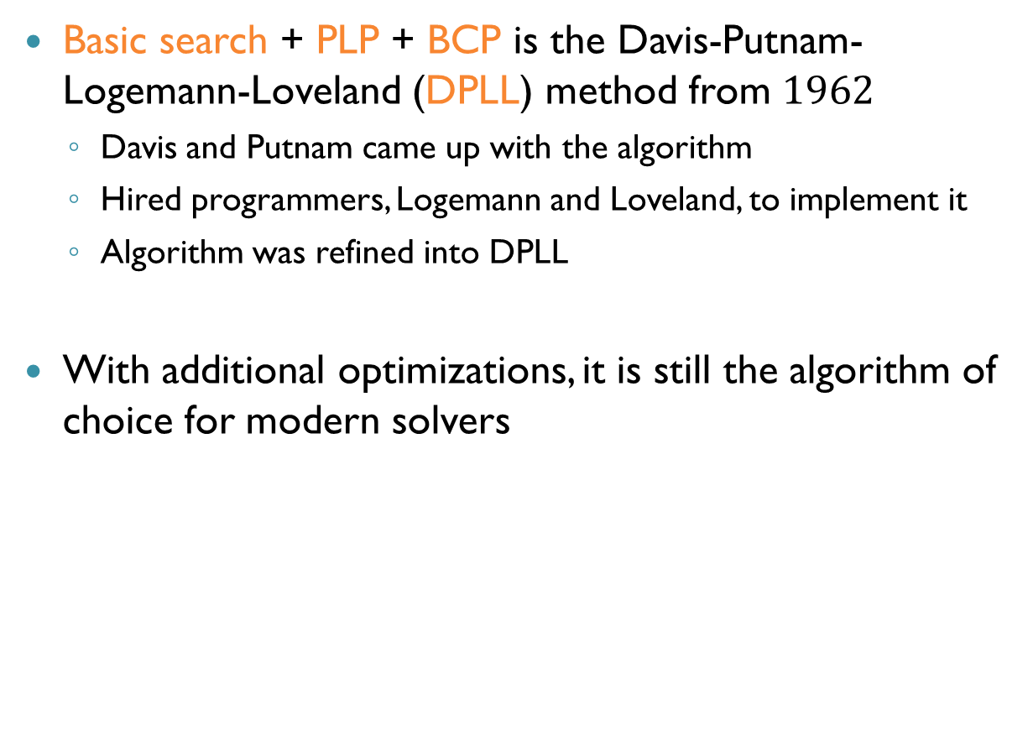
DPLL
Basic search + PLP + BCP is the Davis-Putnam-Logemann-Loveland (DPLL) method from $1962$
Davis and Putnam came up with the algorithm
Hired programmers, Logemann and Loveland, to implement it
Algorithm was refined into DPLL
With additional optimizations, it is still the algorithm of choice for modern solvers

Slide 41
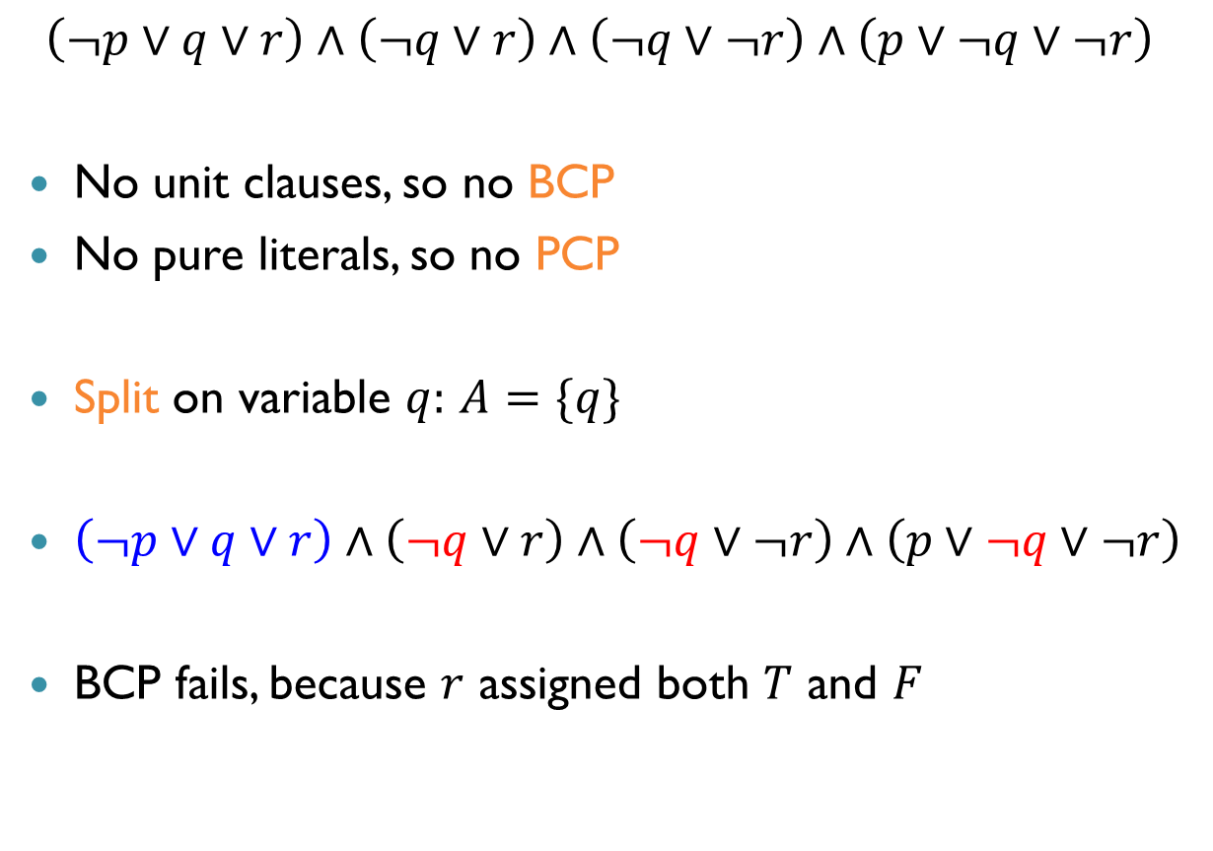
DPLL: Example
$$\left(¬p∨q∨r\right)∧\left(¬q∨r\right)∧\left(¬q∨¬r\right)∧\left(p∨¬q∨¬r\right)$$
No unit clauses, so no BCP
No pure literals, so no PCP
Split on variable $q:$ $A=\{q\}$
$\left(¬p∨q∨r\right)∧\left(¬q∨r\right)∧\left(¬q∨¬r\right)∧\left(p∨¬q∨¬r\right)$
BCP fails, because $r$ assigned both $T$ and $F$

Slide 42
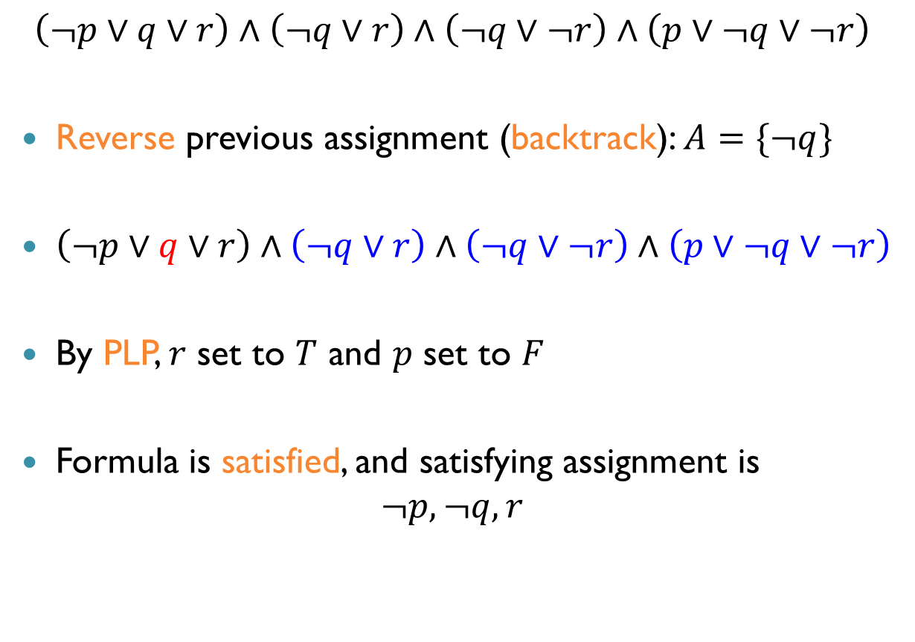
DPLL: Example (cnt’d)
$$\left(¬p∨q∨r\right)∧\left(¬q∨r\right)∧\left(¬q∨¬r\right)∧\left(p∨¬q∨¬r\right)$$
Reverse previous assignment (backtrack): $A=\{¬q\}$
$\left(¬p∨q∨r\right)∧\left(¬q∨r\right)∧\left(¬q∨¬r\right)∧\left(p∨¬q∨¬r\right)$
By PLP, $r$ set to $T$ and $p$ set to $F$
Formula is satisfied, and satisfying assignment is $¬p, ¬q, r$

Slide 43
Summary
Propositional logic, satisfiability, naïve algorithm
Normal forms: NNF, DNF and CNF
Modern SAT solver architecture
Tseitin’s transformation and CNF
The DPLL algorithm: search and deduction

Slide 44
Next Time: Extending DPLL
Non-chronological backtracking
Conflict clause learning
Decision Heuristics
Engineering tricks

